Slide 1
Management Information Systems: Managing the Digital Firm
Fifteenth edition
Chapter 14
Managing Projects

Slide 2
Learning Objectives
14-1 What are the objectives of project management, and why is it so essential in developing information systems?
14-2 What methods can be used for selecting and evaluating information systems projects and aligning them with the firm’s business goals?
14-3 How can firms assess the business value of information systems?
14-4 What are the principal risk factors in information systems projects, and how can they be managed?
Notes:
This chapter discusses the role and importance of managing projects. Have students describe why project management is important to information systems projects. Have some students worked on projects (not necessarily IT projects) at work which were poorly managed? How many have worked on well-managed projects? What were the really significant factors that made for a “well-managed” (or “poorly managed”) project?

Slide 3
Video Cases
Case 1: Blue Cross Blue Shield: Smarter Computing Project
Case 2: NASA Project Management Challenges

Slide 4
Intuit Counts on Project Management
Problem
Fragmented data and systems
Solutions
Hadoop, analytic tools
Intuit implemented strong project management, breaking huge project into chunks, to create an enterprisewide data analytics resource, the Intuit Analytics Cloud
Illustrates the influence of project management in implementing successful IT projects

Slide 5
Runaway Projects and System Failure
Runaway projects: 30–40 percent IT projects
Exceed schedule, budget
Fail to perform as specified
Types of system failure
Fail to capture essential business requirements
Fail to provide organizational benefits
Complicated, poorly organized user interface
Inaccurate or inconsistent data
Notes:
This slide emphasizes the high risk of failure for most IT projects and details the main ways a system can be considered to have “failed.” Some studies have shown that only 29 percent of all technology investments are completed on time, on budget, and with all features and functions specified, and nearly 40 percent suffer some kind of failure mode. Ask students what is meant by “Fail to provide organizational benefits” and provide an example.

Slide 6
Figure 14.1: Consequences of Poor Project Management
Notes:
Figure 14.1, Page 530.
Without proper management, a systems development project takes longer to complete and most often exceeds the allocated budget. The resulting information system most likely is technically inferior and may not be able to demonstrate any benefits to the organization.
This graphic illustrates the main consequences when an information project is not properly managed. Have any students encountered an information system that was too difficult to use or that didn’t work as intended? Have any students experienced a poorly managed project?

Slide 7
Project Management Objectives
Project management
Activities include planning work, assessing risk, estimating resources required, organizing the work, assigning tasks, controlling project execution, reporting progress, analyzing results
Five major variables
Scope
Time
Cost
Quality
Risk
Notes:
This slide introduces the main activities involved in project management, and lists the five major variables that project management must deal with. Ask students to describe what “scope” means. You can also ask students what project management activities concern the five variables. For example, to control scope, project managers define the work as included in the project. To manage the time spent on the project, project management estimates the time to complete each task and schedules the tasks for optimal efficiency.

Slide 8
Management Structure for Information Systems Projects
Corporate strategic planning group
Responsible for firm’s strategic plan
Information systems steering committee
Reviews and approves plans for systems in all divisions
Project management group
Responsible for overseeing specific projects
Project team
Responsible for individual systems project
Notes:
In all but the smallest of firms there is a considerable organizational apparatus involved in projects which is one reason they can be so difficult to manage. In a textbook situation, the corporate planning group decides which general capabilities and functionalities are needed to achieve the firm’s overall strategy. Then an IT steering committee considers the matter and alternative ways to achieve what senior managers want and comes up with one or several projects. This committee assigns a project leader, who in turn selects a project team. The team develops the project and reports back up the line as progress is made.

Slide 9
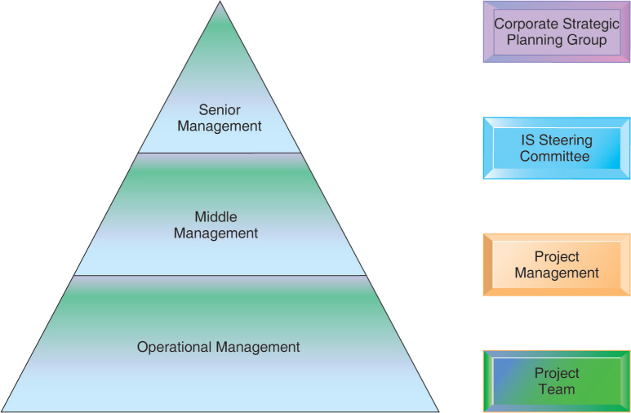
Figure 14.2: Management Control of Systems Projects
Notes:
Figure 14.2, Page 532.
Each level of management in the hierarchy is responsible for specific aspects of systems projects, and this structure helps give priority to the most important systems projects for the organization.
This graphic illustrates what management levels the four main groups are at. Have the students describe the types of decision making (structured, unstructured, etc.) that each of the four groups would be involved in.

Slide 10
Information Systems Plan (1 of 2)
Identifies systems projects that will deliver most business value
Links development to business plan
Road map indicating direction of systems development, includes:
Purpose of plan
Strategic business plan rationale
Current systems/situation
New developments
Management strategy
Implementation plan
Budget
Notes:
This slide emphasizes the importance of making sure systems projects will support the firm’s overall business goals. A key document in ensuring this is the information systems plan. What management decisions are involved in the management strategy? (Hardware acquisition; telecommunications; centralization of authority, data, and hardware; required organizational change)

Slide 11
Information Systems Plan (2 of 2)
For effective plan
Document existing systems and infrastructure components
Identify decision-making improvements
Develop metrics established for quantifying values
Clear understanding of long-term and short-term information requirements
Key performance indicators (KPIs)
Strategic analysis identifies small number of KPIs, determined by managers
Notes:
This slide continues the look at the steps a firm should take in selecting the right systems projects to pursue. Ask students why it is important to inventory existing hardware and software. Ask students to give an example of a long-term information requirement versus a short-term information requirement. The slide also introduces KPIs as a way to evaluate information requirements of a firm. The book also describes other methodologies such as the balanced scorecard method which can also be useful for understanding what projects should be developed.

Slide 12
Portfolio Analysis
Used to evaluate alternative system projects
Inventories all of the organization’s information systems projects and assets
Each system has profile of risk and benefit
High benefit, low risk
High benefit, high risk
Low benefit, low risk
Low benefit, high risk
To improve return on portfolio, balance risk and return from systems investments
Notes:
This slide discusses portfolio analysis, a method used to evaluate alternative systems projects according to their levels of risk and benefit. In portfolio analysis, you seek to have a balance between types of systems, based on the level of risk you can afford, similar to a financial portfolio. Ask students what kinds of systems projects would be riskier than others. How could you determine the relative benefit of an information system?

Slide 13
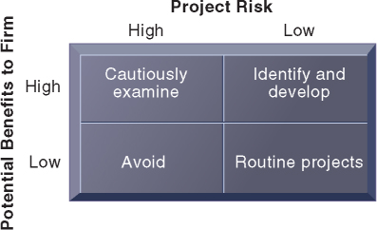
Figure 14.3: A System Portfolio
Notes:
Figure 14.3, Page 535.
Companies should examine their portfolio of projects in terms of potential benefits and likely risks. Certain kinds of projects should be avoided altogether and others developed rapidly. There is no ideal mix. Companies in different industries have different profiles.
This graphic illustrates the priorities a firm should give to information systems with different levels of risk and benefit. The only projects to avoid are high-risk, low-benefit projects. The emphasis given to any of the other three categories depends upon the individual firm. What types of influences on or within a firm might alter the firm’s emphasis on one category (e.g., high-benefit, high-risk) over another?

Slide 14
Scoring Models
Used to evaluate alternative system projects, especially when many criteria exist
Assigns weights to various features of system and calculates weighted totals
Many qualitative judgments involved
Requires experts who understand the issues and the technology

Slide 15
Table 14.2 Example of a Scoring Model for an ERP System
CRITERIA | WEIGHT | ERP SYSTEM A % | ERP SYSTEM A SCORE | ERP SYSTEM B % | ERP SYSTEM B SCORE
1.1 Online order entry | 4 | 67 | 268 | 73 | 292
1.2 Online pricing | 4 | 81 | 324 | 87 | 348
1.3 Inventory check | 4 | 72 | 288 | 81 | 324
1.4 Customer credit check | 3 | 66 | 198 | 59 | 177
1.5 Invoicing | 4 | 73 | 292 | 82 | 328
2.1 Production forecasting | 3 | 72 | 216 | 76 | 228
2.2 Production planning | 4 | 79 | 316 | 81 | 324
(etc.) | (etc.) | (etc.) | (etc.) | (etc.) | (etc.)
GRAND TOTALS | - | - | 3,128 | - | 3,300

Slide 16
Information System Costs and Benefits
Tangible benefits
Can be quantified and assigned monetary value
Systems that displace labor and save space:
Transaction and clerical systems
Intangible benefits
Cannot be immediately quantified but may lead to quantifiable gains in the long run
For example, more efficient customer service, enhanced decision making
Systems that influence decision making:
ESS, DSS, collaborative work systems
Notes:
In portfolio analysis, systems are compared along the lines of risk and benefit. This slide examines the ways a project’s benefits can be identified and quantified or evaluated. In addition to direct costs (costs for hardware, services, personnel, etc.) there are tangible benefits and intangible benefits. Ask students to provide examples of tangible and intangible benefits. Note that Chapter 5 introduced the total cost of ownership (TCO) method for evaluating the cost of information systems projects. The TCO method does include expenditures beyond the initial cost of purchasing and installing hardware and software, but does not typically deal with benefits, cost categories such as complexity costs, or “soft” and strategic factors discussed later.

Slide 17
Capital Budgeting for Information Systems
Capital budgeting models
Measure value of long-term capital investment projects
Rely on measures of the firm’s cash outflows and inflows
Principle capital budgeting models used to evaluate IT projects
Payback method
Accounting rate of return on investment (ROI)
Net present value
Internal rate of return (IRR)
Limitations of financial models
Notes:
This slide introduces the practice of using financial analysis to determine what the return on investment is for an information systems project. Ask students why using these capital budgeting methods may be more accurate in understanding the value of an information system rather than a TCO approach. At the same time, what are some of the pitfalls of using only an ROI approach to investing in IT? Although costs might be relatively easy to establish, benefits are not so easy to identify, and especially in a quantitative manner.
Financial accounting methods do not take into account all of the factors that can affect costs and benefits. Ask the students to describe some of the factors that may affect revenues or costs (costs from organizational disruptions: cost to train end users, productivity costs due to users’ learning curves for a new system, time managers need to spend overseeing new system-related changes) as well as some of the benefits that may not be addressed by financial methods (more timely decisions from a new system, enhanced employee learning and expertise).

Slide 18
Dimensions of Project Risk
Project size
Cost
Time
Number of organizational units affected
Organizational complexity
Project structure
Structured, defined requirements run lower risk
Experience with technology
Team familiar with hardware and software
Notes:
This slide discusses a second major factor in evaluating projects, risk. (Remember that portfolio analysis ranks systems according to two criteria, benefit and risk.) Most managers don’t like to think about risk and most make no attempt to measure it. Most managers are optimists and think about benefits. As we all know from the recent financial meltdown, financial managers did not seriously consider risk, and they might be fired if they did. A great many systems projects fail which could have been avoided had managers a better understanding of project risk.
What is meant by risk? Ask students how the size of a project affects its risk. What does organizational complexity mean in this context? Which of these components are organizational versus technical? Can all of them be countered through better project management?

Slide 19
Interactive Session: Management: Can the National Health Service Go Paperless?
Class discussion
Why is paperless NHS a risky project? Identify the key risk factors.
What management, organization, and technology problems is the paperless NHS likely to encounter?
What steps should be taken to make the paperless NHS more successful?

Slide 20
Change Management and the Concept of Implementation (1 of 2)
Change management
Required for successful system building
New information systems have powerful behavioral and organizational impact
Implementation
All organizational activities working toward adoption, management, and routinization of an innovation
Change agent
One role of systems analyst
Redefines the configurations, interactions, job activities, and power relationships of organizational groups
Notes:
This slide emphasizes that introduction or alteration of an information system has a powerful behavioral and organizational impact. Change management is required to counter resistance and opposition. Ask students for examples of behavioral and organizational impacts that a new information system might have. What types of changes should an analyst look for in assessing the impact of a new system?
This slide introduces the concept of implementation and the role of the systems analyst as a change agent, a key role in change management efforts. Ask students what types of activities a change agent would engage in to encourage the adoption of a new information system throughout the enterprise. Why don’t employees and managers simply adopt new systems without question?

Slide 21
Change Management and the Concept of Implementation (2 of 2)
Role of end users
With high levels of user involvement
System more likely to conform to requirements
Users more likely to accept system
User–designer communication gap
Users and information systems specialists
Management support and commitment
Effects positive perception by both users and technical staff
Ensures sufficient funding and resources
Helps enforce required organizational changes
Notes:
Two important factors in successful implementation are user involvement and management support. This slide discusses the role of users and the effects of the user–designer communications gap. Ask students to provide examples of user concerns and designer concerns regarding an information system. What are the goals of these two groups?
This slide discusses a second major factor in successful implementation—management support. It is particularly important to note that if management gives high priority to a project then the project will more likely be treated the same way by users. In what ways can management show support for a project? Which of these are most likely to influence users and technical staff? Why would managers sometimes not show enthusiastic support for a project? (Sometimes, personal, political, and organizational culture differences reduce support for some projects.)

Slide 22
Change Management Challenges for Business Process Reengineering, Enterprise Applications, and Mergers and Acquisitions
Very high failure rate among enterprise application and BPR projects (up to 70 percent for BPR)
Poor implementation and change management practices
Employee concerns about change
Resistance by key managers
Changing job functions, career paths, recruitment practices
Mergers and acquisitions
Similarly high failure rate of integration projects
Merging of systems of two companies requires:
Considerable organizational change, complex systems projects
Notes:
This slide emphasizes the high failure rate for large-scale enterprise and business process redesign projects and the importance of implementation and change management. To some extent, the failure rate has declined in recent years as the major vendor firms stabilized their offerings, making the technology less of a risk. In turn, large corporations have developed a deep experience base with large scale systems. Nevertheless, large-scale system implementations almost invariably run over budget, and are behind schedule.
Ask students to recall what implementation means. Ask students why both employees and managers become concerned about changes to functions and career paths.

Slide 23
Controlling Risk Factors
First step in managing project risk involves identifying nature and level of risk of project.
Each project can then be managed with tools and risk-management approaches geared to level of risk.
Managing technical complexity
Internal integration tools
Project leaders with technical and administrative experience
Highly experienced team members
Frequent team meetings
Securing of technical experience outside firm if necessary
Notes:
The next slides discuss various project management, requirements gathering, and planning methodologies that can be used to counter different types of implementation problems. First, technical complexity can be managed by using internal integration tools. Why are these called “internal integration” tools?

Slide 24
Formal Planning and Control Tools
Used for documenting and monitoring project plans
Help identify bottlenecks and impact of problems
Gantt charts
Visual representation of timing and duration of tasks
Human resource requirements of tasks
PERT charts
Graphically depict tasks and interrelationships
Indicate sequence of tasks necessary

Slide 25
Figure 14.4: A Gantt Chart (1 of 3)
Notes:
Figure 14.4, Page 545.
The Gantt chart in this figure shows the task, person-days, and initials of each responsible person as well as the start and finish dates for each task. The resource summary provides a good manager with the total person-days for each month and for each person working on the project to manage the project successfully. The project described here is a data administration project.
This slide and the next two show the top, middle, and bottom portions of a Gantt Chart. The orange lines show the beginning, duration, and end of each task. Organizing a project in this way can allow a manager to see what is or should be worked on at any given time

Slide 26
Figure 14.4: A Gantt Chart (2 of 3)
Notes:
Figure 14.4, Page 545.
This slide shows the middle of the Figure 14-4 Gantt chart.

Slide 27
Figure 14.4: A Gantt Chart (3 of 3)
Notes:
Figure 14.4, Page 545.
This slide shows the Resource Summary section at the bottom of the Figure 14-4 Gantt chart. Here you can see total numbers of human work days across the bottom of the chart.

Slide 28
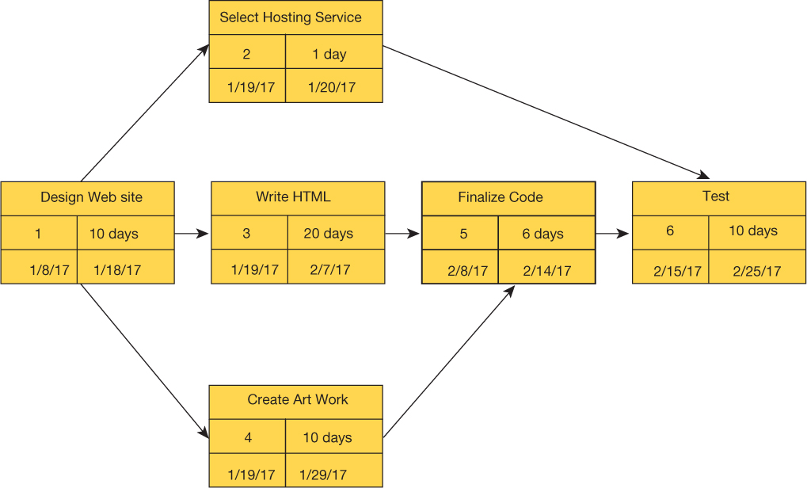
Figure 14.5: A PERT Chart
Notes:
Figure 14.5, Page 546.
This is a simplified PERT chart for creating a small website. It shows the ordering of project tasks and the relationship of a task with preceding and succeeding tasks.
This graphic is a simplified PERT chart, which shows the dependencies between project tasks. Ask students to define what “dependencies” means and to point out the dependencies in this chart. Why are dependencies important to consider when managing a project?

Slide 29
Increasing User Involvement and Overcoming User Resistance
External integration tools
Link work of implementation team to users at all levels
User resistance to organizational change
Counterimplementation
Strategies to overcome user resistance
User participation, education and training
Management edicts and policies
Incentives for cooperation
Improvement of end-user interface
Resolution of organizational problems prior to introduction of new system
Notes:
This slide discusses a third type of tool to meet implementation challenges—external integration tools—and discusses the forms that user resistance may take. Ask students if they have ever witnessed user resistance to an information system at their work places.
This slide discusses methods to counter user resistance. Ask students why simply declaring a system “mandatory” may not be the best approach to effect user participation.

Slide 30
Interactive Session: Organizations: Snohomish County Public Utility District Implements a New Human Resources System
Class discussion
How important was the human resources project for Snohomish PUD? Why?
Classify and describe the management, organization, and technology issues the project had to address in order to implement the new system successfully. How did the project team deal with these issues?
Describe the composition of the project team. How important was this? Why?
Why do you think the implementation of Snohomish PUD’s new human resource system was successful? Explain your answer.

Slide 31
Designing for the Organization
Need to address ways in which organization changes with new system
Ergonomics
Interaction of people and machines in work environment
Organizational impact analysis
How system will affect organizational structure, attitudes, decision making, operations
Sociotechnical design
Addresses human and organizational issues
Notes:
This slide discusses the ways in which a new information system can impact an organization. Table 14-5 in the text lists the organizational factors in systems planning and implementation. Ask students to identify some of these. (Employee participation and involvement, job design, standards and performance monitoring, ergonomics, employee grievance resolution procedures, health and safety, government regulatory compliance)
This slide discusses the use of an organizational impact analysis to anticipate how an upcoming system will affect an organization. It also discusses the use of sociotechnical design, a method to address human and organizational practices into information systems projects.

Slide 32
Project Management Software Tools
Can automate many aspects of project management
Capabilities for defining, ordering tasks
Assigning resources to tasks, tracking progress
Manage very large numbers of tasks and relationships
Microsoft Project
Cloud-based software
Project portfolio management software
Notes:
This slide discusses commercial software that is available to assist in managing projects, the most popular of which is Microsoft Project. There are also numerous online project management tools available over the Internet, from time-tracking tools to groupware. Ask students if they have ever used any project management software.

